Slide 1

SURF REPORT MODEL OPTIMIZATION
TIANYI WU YONGRUN HUANG WEEK4

Slide 2

FURTHER IMPROVEMENT

Slide 3

SOMETHING WE ADD

Slide 4


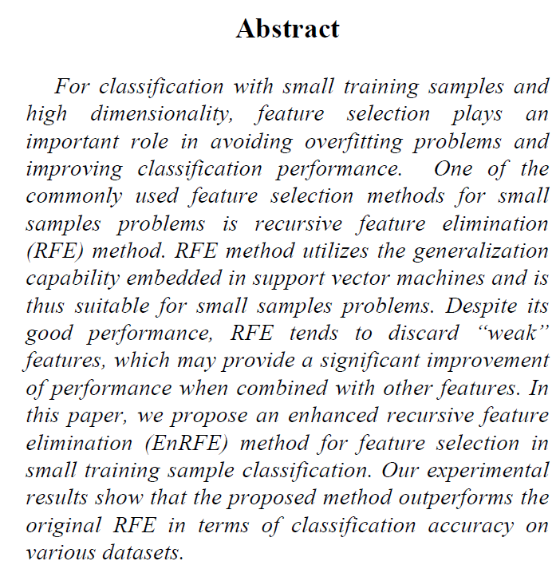
REF（Recursive Feature Elimination）
Paper we learned from
Improve model interpretability: By identifying important features, the decision-making process of the model can be better understood.
Reduce overfitting: Removing unimportant features may reduce the complexity of the model, thereby reducing the risk of overfitting.
Improved model performance: In some cases, removing noise features can improve the prediction accuracy of the model.
Reduced computational costs: Reducing the number of features reduces computational costs for model training and prediction.
DOI: 10.1109/ICMLA.2007.35

Slide 5
GridSearch
Comprehensiveness: Systematically traverses all preset parameter combinations to ensure that nothing is missed.
Scalability: Easy to adapt to multi-parameter optimization problems.
Certainty: The results can be repeated, which contributes to the reproducibility of the experiment.
Cross-validation: Used in combination to evaluate the generalization ability of the model.
Universality: Applicable to many different machine learning models.
Easy to understand: the method is intuitive and easy to learn and implement.
Parallelization: Supports parallel processing to improve search efficiency.
Flexibility: Customize the parameter grid to suit different search needs.
Best parameters found by Grid Search: {'lstm_hidden_dim': 100, 'num_lstm_layers': 2, 'learning_rate': 0.001}
Best parameters found by Grid Search: {'lstm_hidden_dim': 100, 'num_lstm_layers': 1, 'learning_rate': 0.001}

Slide 6
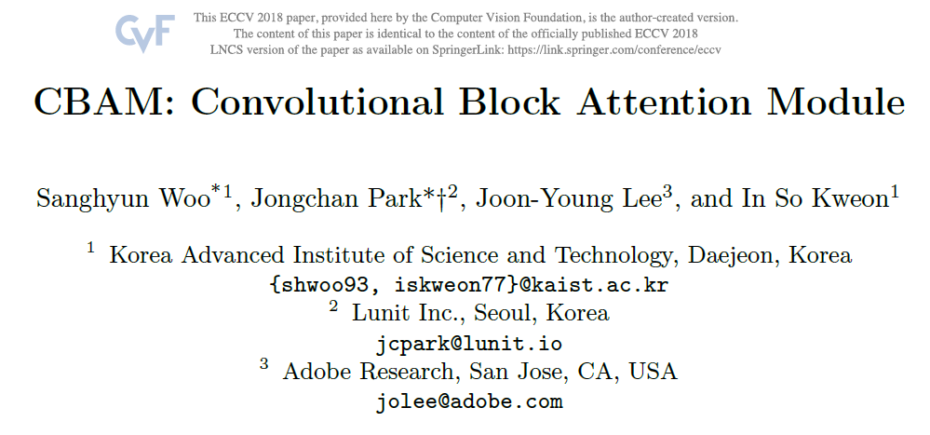
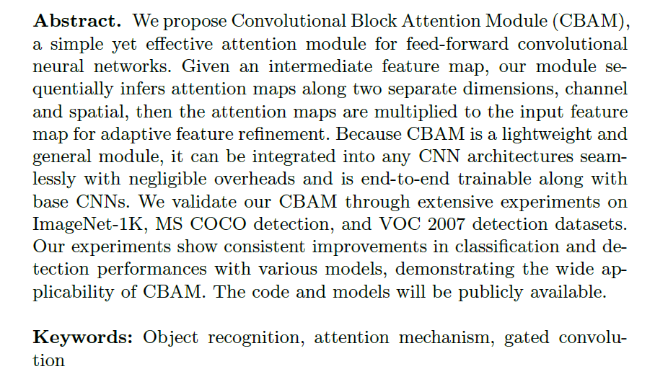
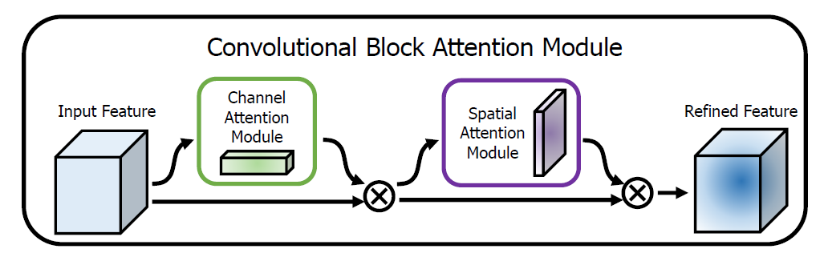
CBAM: Convolutional Block Attention Module
A novel attentional mechanism module designed to improve the presentation capability of CNN through the attention mechanism, while maintaining a small computing overhead.
CBAM architecture
Channel attention module: By using the relationships between channels in the feature map to generate attention maps, focus on the meaningful "what" in the image.
Spatial attention module: By using spatial relationships of features to generate attention maps, focus on the "where" of information-rich areas in the image.

Slide 7
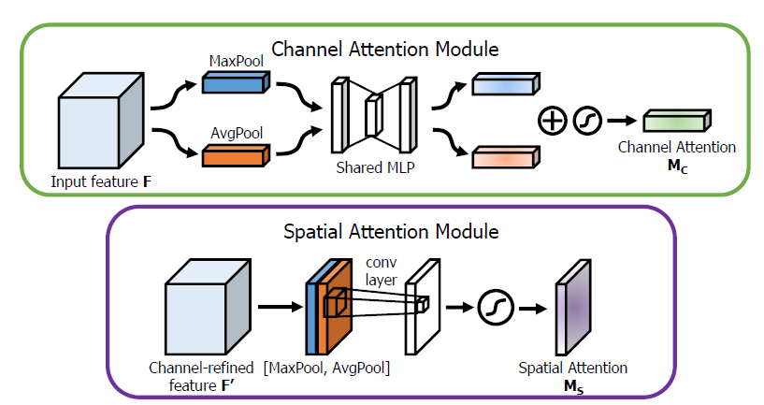
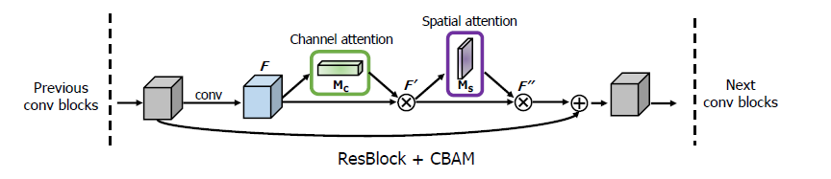

Slide 8
Inner Principle and Implementation
Channel Attention: The purpose of channel attention is to determine the importance of features of different channels.It aggregates spatial information through Global Average Pooling (GAP) and Global Max Pooling (GMP) to obtain the global spatial characteristics of each channel.These global features are processed through a shared multi-layer perceptron (MLP) to learn the weight of each channel.Finally, the channel attention weight generated by the sigmoid function is multiplied with the corresponding channel of the original feature map to achieve weighting.
Spatial Attention: Spatial attention is concerned with the importance of different spatial positions within each channel in the feature map.It aggregates channel information by applying average pooling and maximum pooling on each channel respectively to obtain the global characteristics in space.These features are also processed through a convolution layer to learn the weight of each spatial position.The attention weight obtained by the sigmoid function is used to weight the corresponding spatial position of the original feature map.
Combined attention: The results of channel attention and spatial attention are multiplied to account for the importance in both dimensions at the same time, resulting in a final weighted feature map.

Slide 9
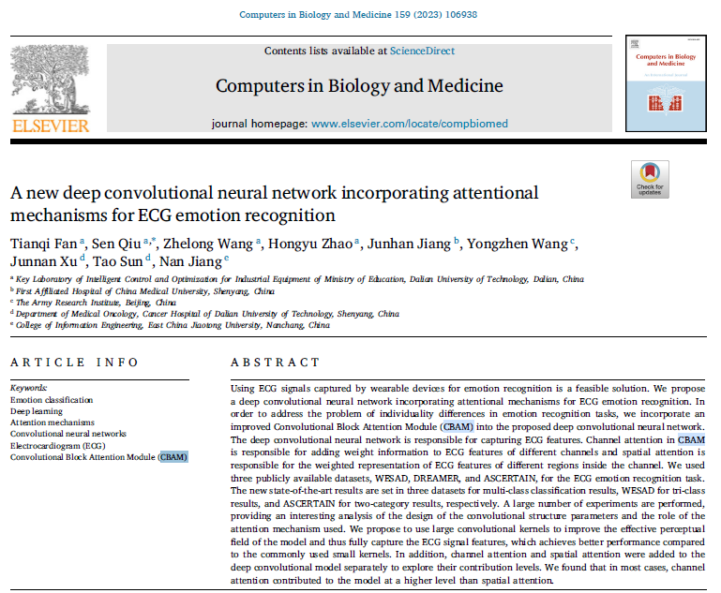
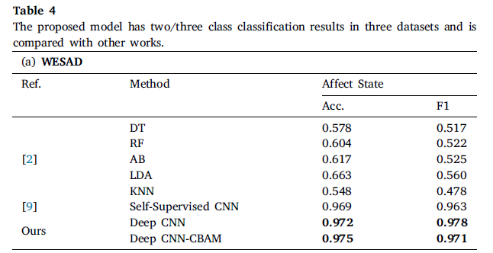
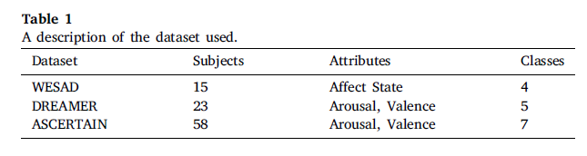
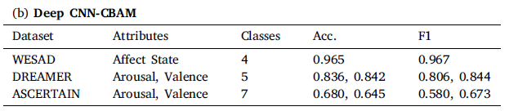
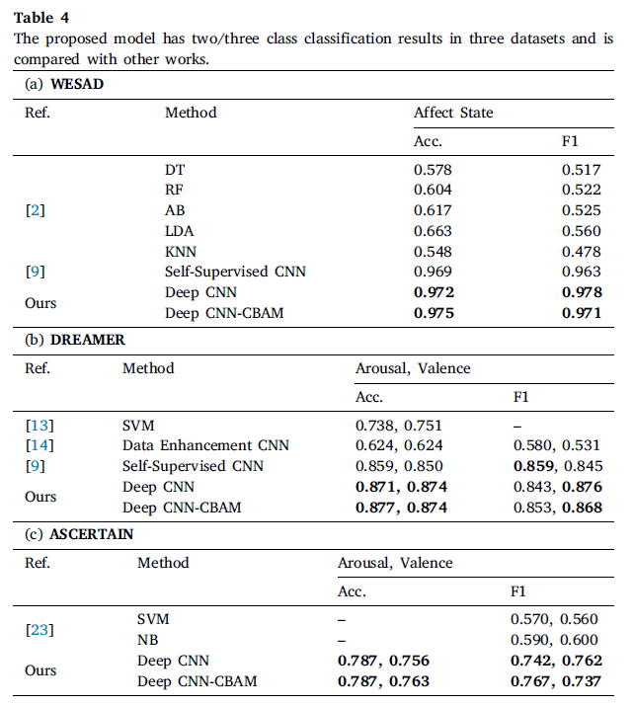

Slide 10
LSTM （Long Short-Term Memory）
Powerful sequence processing capabilities and flexibility
Solve the long-term dependency problem: LSTM can learn the long-term time dependency of data through the mechanism of forget gate and update gate.
Parameter sharing: LSTM uses the same weight for each time step of the sequence, which reduces the number of parameters in the model and improves the generalization ability of the model.
Better gradient flow: Due to the nonlinear activation function of the forget gate and update gate, the LSTM avoids the gradient disappearance problem, allowing the gradient to flow more efficiently over time steps.
Flexibility and applicability: LSTM can process a variety of sequence data, including text, speech, time series predictions, and more.

Slide 11
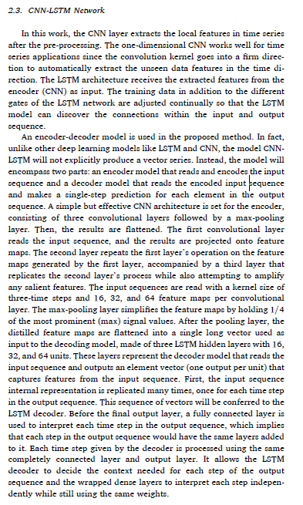
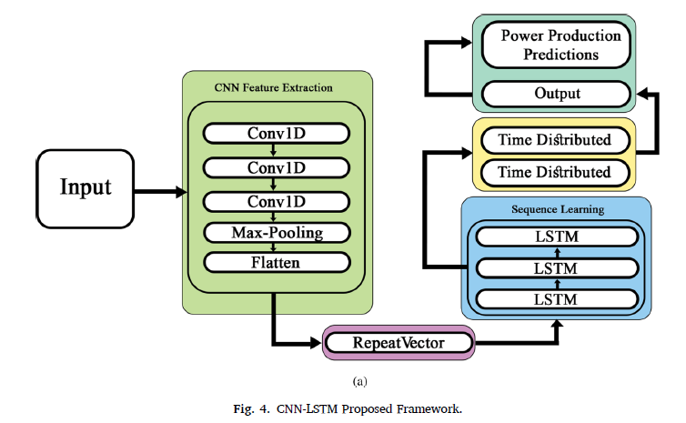

LSTM （Long Short-Term Memory）

Slide 12
TWO MODELS
3 CLASSFICATION
NEUTRAL - STRESS – AMUSSMENT
MODEL STRUCTURE:
Random Forest embedded with RFE（Recursive Feature Elimination）
Advantage: Ensure that the selected feature subset can steadily improve the performance of the model
GridSearch
Advantage: Find the best hyperparameters
CNN with CBAM（Convolutional Block Attention Module）
Advantage:
Dual attention mechanism, able to focus on important features in both channel and spatial dimensions
Reduce the cost of calculations, resulting in improved performance
LSTM （Long Short-Term Memory）
Advantage: Hybrid learning model , especially suitable for working with data with time series properties
SELF-ATTENTION
TTT（Test-Time Training）(Not currently in use)
10-fold Cross Validation
OUTCOME TESTING ACCURACY
87.78%
BINARY CLASSFICATION
STRESS – NONSTRESS
MODEL STRUCTURE:
Random Forest embedded with RFE（Recursive Feature Elimination）
Advantage: Ensure that the selected feature subset can steadily improve the performance of the model
GridSearch
Advantage: Find the best hyperparameters
CNN-LSTM （Long Short-Term Memory）
Advantage: Hybrid learning model , especially suitable for working with data with time series properties
SELF-ATTENTION
10-fold Cross Validation
OUTCOME TESTING ACCURACY
99.07 %

